Slide 1
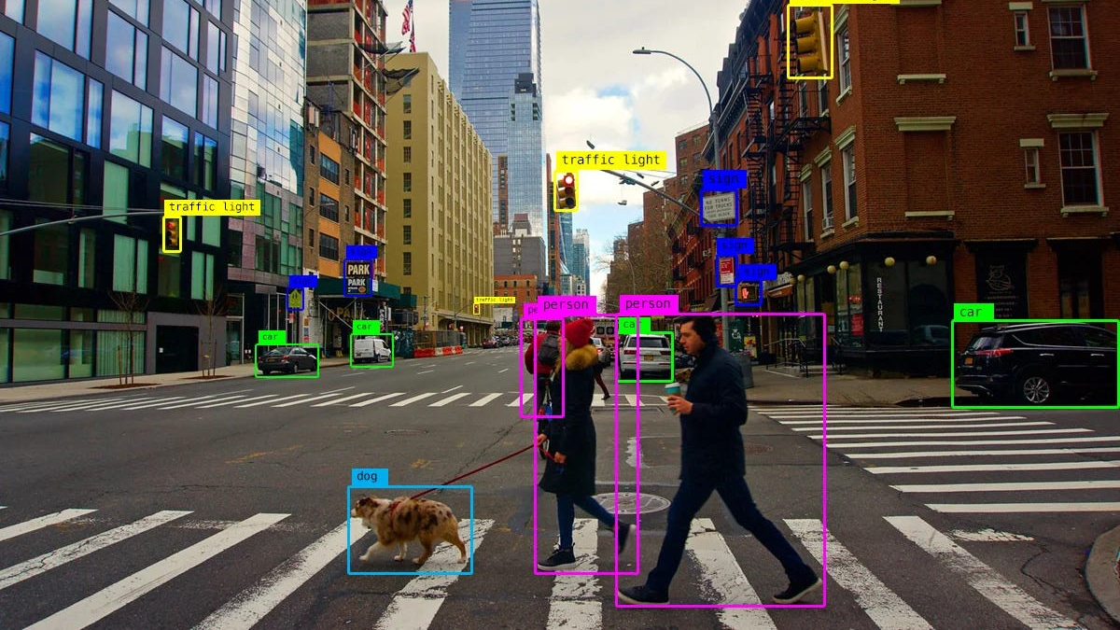
Object Detection Algorithms
Suleimenova Inkara

Slide 2
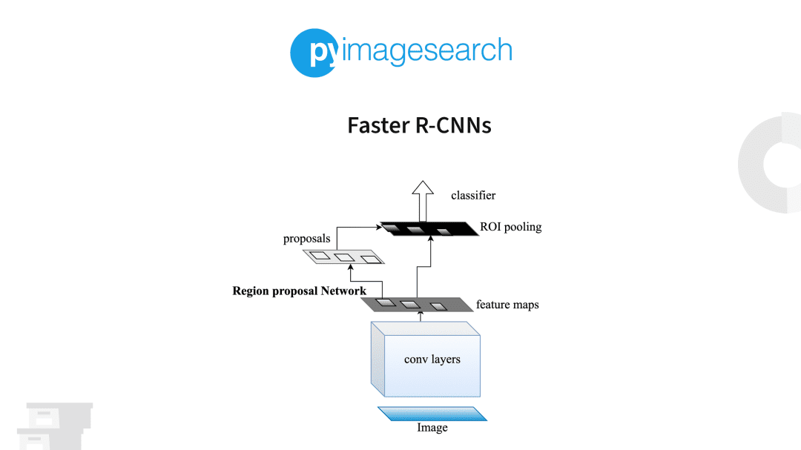
Faster R-CNN
Introduction
While the R-CNN model was able to perform the computation of object detection and achieve desirable results, there were some major lackluster elements, especially the speed of the model. So, faster methods for tackling some of these issues had to be introduced to overcome the problems that existed in R-CNN. Firstly, the Fast R-CNN was introduced to combat some of the pre-existing issues of R-CNN.
In the fast R-CNN method, the entire image is passed through the pre-trained Convolutional Neural Network instead of considering all the sub-segments. The region of interest (RoI) pooling is a special method that takes two inputs of the pre-trained model and selective search algorithm to provide a fully connected layer with an output. In this section, we will learn more about the Faster R-CNN network, which is an improvement on the fast R-CNN model.

Slide 3
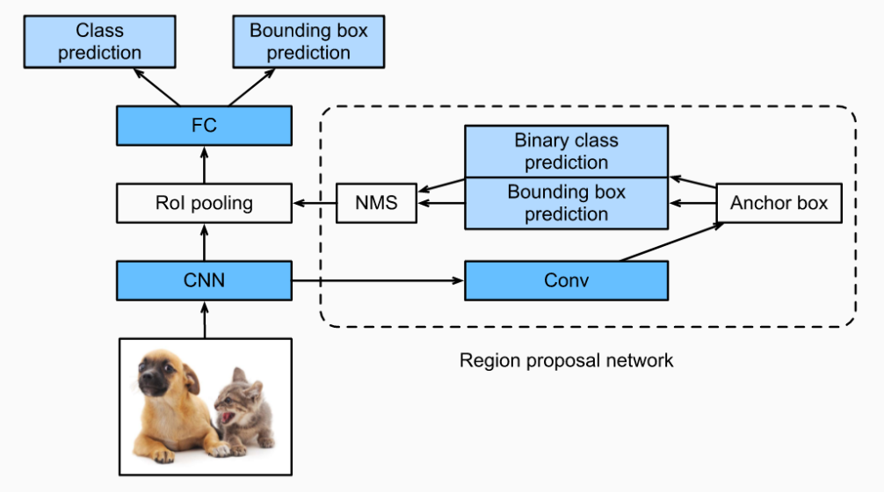
Faster R-CNN
Understanding Faster R-CNN
The Faster R-CNN model is one of the best versions of the R-CNN family and improves the speed of performance tremendously from its predecessors. While the R-CNN and Fast R-CNN model make use of a selective search algorithm to compute the region proposals, the Faster R-CNN method replaces this existing method with a superior region proposal network. The region proposal network (RPN) computes images from a wide range and different scales to produce effective outputs.

Slide 4
Faster R-CNN
Understanding Faster R-CNN
The regional proposal network reduces the margin computation time, usually 10 ms per image. This network consists of the convolutional layer from which we can obtain the essential feature maps of each pixel. For each feature map, we have multiple anchor boxes which have varying scales, different sizes, and aspect ratios. For each anchor box, we make a prediction of the particular binary class and generate a bounding box for the same.

Slide 5
Faster R-CNN
Understanding Faster R-CNN
The following information is then passed through the non-maximum suppression to remove any unnecessary data since many overlaps are produced while creating the feature maps. The output from the non-maximum suppression is passed through the region of interest, and the rest of the process and computation is similar to the working of Fast R-CNN.

Slide 6
Faster R-CNN
Points to consider
Limitations – One of the main limitations of the Faster R-CNN method is the amount of time delay in the proposition of different objects. Sometimes, the speed depends on the type of system being used.
When To Use Faster R-CNN? – The time for prediction is faster compared to other CNN methods. While R-CNN usually takes around 40-50 seconds for the prediction of objects in an image, the Fast R-CNN takes around 2 seconds, but the Faster R-CNN returns the optimal result in just about 0.2 seconds.
Example use cases – The examples of use cases for Faster R-CNN are similar to the ones described in the R-CNN methodology. However, with Faster R-CNN, we can perform these tasks optimally and achieve results more effectively.

Slide 7
Comparison: Faster R-CNN vs Viola-Jones
Feature | Faster R-CNN | Viola-Jones
Detection Type | Object detection (detects multiple objects) | Face detection (primarily designed for faces)
Speed | Slower than YOLO, but more accurate | Faster than R-CNN, but slower than deep learning methods
Accuracy | High accuracy due to region proposal network (RPN) and CNN-based classification | Lower accuracy, higher false positives
Training Data | Requires a large labeled dataset (e.g., COCO, Pascal VOC) | Uses Haar-like features trained on face images
Algorithm Type | Two-stage deep learning model (Region Proposal + Classification) | Cascade classifier using hand-crafted features
Generalization | Can detect multiple objects, even in complex scenes | Struggles with detecting non-face objects
Hardware Requirements | Requires high computational power (GPU recommended) | Runs efficiently on CPU

Slide 8

YOLO (You Only Look Once)
Introduction
You only look once (YOLO) is one of the most popular model architectures and algorithms for object detection. Usually, the first concept found on a Google search for algorithms on object detection is the YOLO architecture. There are several versions of YOLO, which we will discuss in the upcoming sections. The YOLO model uses one of the best neural network archetypes to produce high accuracy and overall speed of processing. This speed and accuracy is the main reason for its popularity.

Slide 9
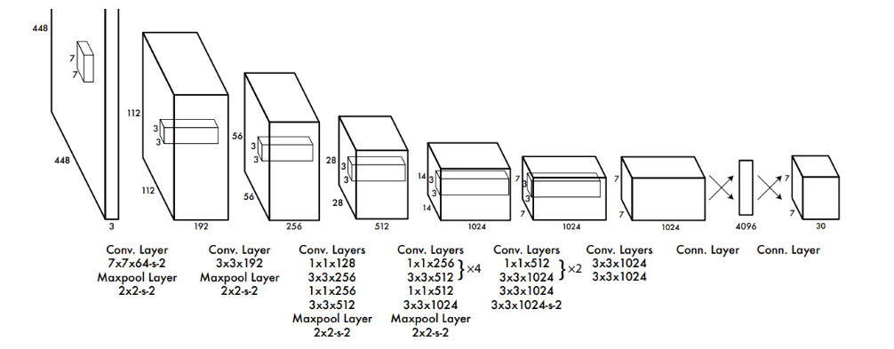
YOLO (You Only Look Once)
Working process of YOLO
The YOLO architecture utilizes three primary terminologies to achieve its goal of object detection. Understanding these three techniques is quite significant to know why exactly this model performs so quickly and accurately in comparison to other object detection algorithms. The first concept in the YOLO model is residual blocks. In the first architectural design, they have used 7×7 residual blocks to create grids in the particular image.

Slide 10
YOLO (You Only Look Once)
Working process of YOLO
Each of these grids acts as central points and a particular prediction for each of these grids is made accordingly. In the second technique, each of the central points for a particular prediction is considered for the creation of the bounding boxes. While the classification tasks work well for each grid, it’s more complex to segregate the bounding boxes for each of the predictions that are made. The third and final technique is the use of the intersection of union (IOU) to calculate the best bounding boxes for the particular object detection task.

Slide 11
YOLO (You Only Look Once)
Advantages of YOLO
Limitations of YOLO
The computation and processing speed of YOLO is quite high, especially in real-time compared to most of the other training methods and object detection algorithms.
Apart from the fast computing speed, the YOLO algorithm also manages to provide an overall high accuracy with the reduction of background errors seen in other methods.
The architecture of YOLO allows the model to learn and develop an understanding of numerous objects more efficiently.
Failure to detect smaller objects in an image or video because of the lower recall rate.
Cant’t detect two objects that are extremely close to each other due to the limitations of bounding boxes.

Slide 12
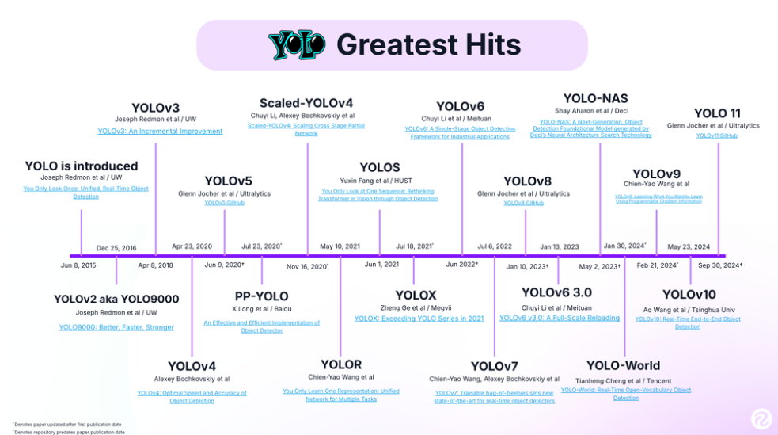
YOLO (You Only Look Once)
Versions of YOLO
The YOLO architecture is one of the most influential and successful object detection algorithms. With the introduction of the YOLO architecture in 2016, their consecutive versions YOLO v2 and YOLO v3 arrived in 2017 and 2018. While there was no new release in 2019, 2020 saw three quick releases: YOLO v4, YOLO v5, and PP-YOLO. Each of the newer versions of YOLO slightly improved on their previous ones. The tiny YOLO was also released to ensure that object detection could be supported on embedded devices.

Slide 13
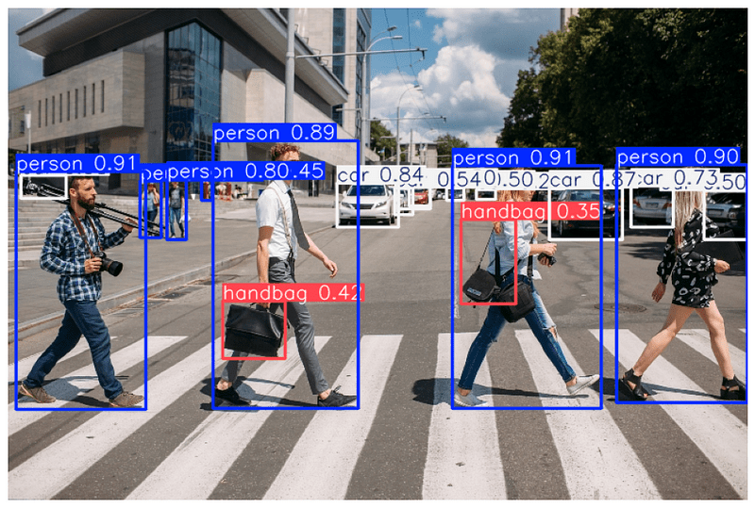
YOLO (You Only Look Once)
Points to consider
When To Use YOLO? – While all the previously discussed methods perform quite well on images and sometimes video analysis for object detection, the YOLO architecture is one of the most preferred methods for performing object detection in real-time. It achieves high accuracy on most real-time processing tasks with a decent speed and frames per second depending on the device that you’re running the program on.

Slide 14
Comparison: YOLO vs Viola-Jones
Feature | YOLO (You Only Look Once) | Viola-Jones
Detection Type | Object detection (detects multiple objects in a single pass) | Face detection (primarily designed for face detection)
Speed | Very fast (real-time processing) | Relatively slow compared to modern deep learning methods
Accuracy | High accuracy with deep learning-based feature extraction | Lower accuracy, higher false positives
Training Data | Requires a large dataset (e.g., COCO) | Uses Haar cascades trained on positive and negative samples
Algorithm Type | Deep learning-based convolutional neural network (CNN) | Feature-based cascade classifier using Haar-like features
Generalization | Can detect multiple types of objects (people, cars, animals, etc.) | Primarily used for face detection, struggles with non-face objects
Hardware Requirements | Requires GPU for optimal performance | Can run efficiently on CPU

Slide 15

Thank you for attention!

Slide 16
References
Bharath K. Object Detection Algorithms and Libraries. – URL: https://neptune.ai/blog/object-detection-algorithms-and-libraries (15.04.2024)
Joseph Nelson. What is YOLO? The Ultimate Guide [2025]. – URL: https://blog.roboflow.com/guide-to-yolo-models/ (09.01.2025)

